Slide 1

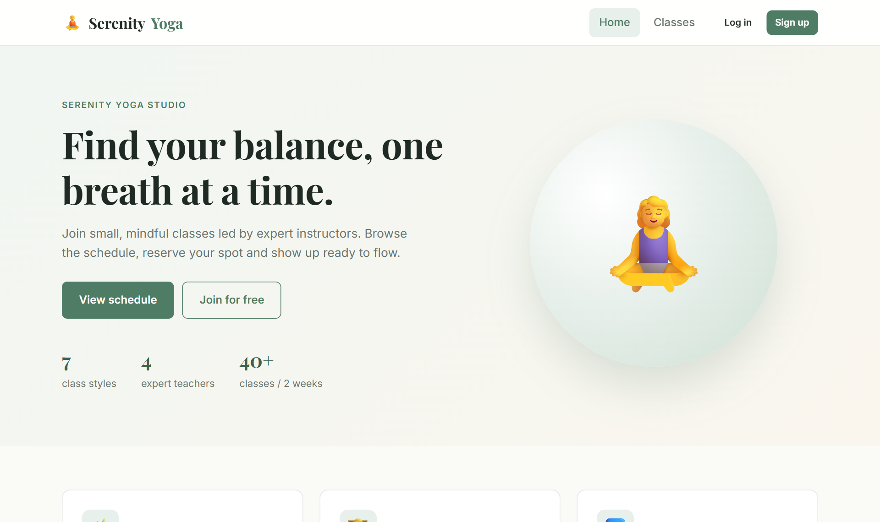
Yoga Class Booking System
WEB TECHNOLOGY · 23CS2048
A real-time web application for booking yoga classes, built with React, Node.js, Express and MongoDB Atlas
Serenity Yoga – home page
STUDENT NAME (REG.NO)
Division of Computer Science and Engineering
Karunya Institute of Technology and Sciences
Notes:
Introduce the project: Serenity Yoga, a yoga class booking system. It lets members browse and book classes online and lets the studio admin manage the schedule. Built as a full-stack JavaScript application: React frontend, Node.js and Express backend, MongoDB Atlas database.

Slide 2


From phone bookings to real-time online reservations
The problem
Our solution
Classes booked by phone or walk-in, recorded by hand
Members cannot see which classes still have space
Overbooking and double bookings happen easily
No single view of attendance or revenue for the studio
Online schedule with live “spots left” for every class
One-click booking and cancellation for members
Server rules block full classes, double and late bookings
Admin dashboard for classes, attendees and statistics
Notes:
Explain the problem with manual booking and how the system solves each point. Mention that availability is calculated live from the database every time the schedule loads.

Slide 3






Six core features for members and administrators
Browse & filter
Live availability
One-click booking
Two-week schedule grouped by day, with search and filters for style, level and date
Each class shows booked seats and spots left, calculated from MongoDB
Members book instantly; guests are sent to log in first, then returned
My bookings
Admin dashboard
Secure accounts
Upcoming, past and cancelled tabs, with confirmed cancellation
Statistics, create / edit / delete classes, view and remove attendees
Registration and login with hashed passwords and JWT sessions
Notes:
Walk through the six features. Members: browse, live availability, booking, my bookings. Admin: dashboard. Security covers both.

Slide 4



A full JavaScript stack: React, Node.js and MongoDB
Frontend (UI)
Backend (Server)
Database
HTML5 and CSS3 (Grid, Flexbox, media queries)
JavaScript (ES6+)
React 18 with Vite
React Router 6 – protected routes
Context API and custom hooks
Node.js 24 runtime
Express.js 4 REST API
JSON Web Token (JWT) auth
bcrypt.js password hashing
CORS and .env configuration
MongoDB Atlas (cloud cluster)
Mongoose 8 ODM with schemas
Collections: users, yogaclasses, bookings
Unique and compound indexes
Aggregation for seat counts
Notes:
The whole application uses JavaScript: React in the browser, Node and Express on the server, and MongoDB stores JSON-like documents, so data flows as JSON end to end.

Slide 5


Three tiers communicate through a JSON REST API
React SPA (client)
Express API (server)
MongoDB Atlas
Browser · localhost:5173
Node.js · localhost:5000
cluster0 · yoga_booking
Pages: Home, Classes, Details, Login, Register, My Bookings, Admin
AuthContext + ToastContext
Fetch API with JWT header
HTTP + JSON
Routes: /api/auth, /classes, /bookings, /admin
Validation and business rules
Central error handling
Mongoose
users
yogaclasses
bookings
Express middleware chain for every request
cors()
express.json()
auth (JWT)
adminOnly
route handler
error handler
Notes:
The React app runs in the browser and calls the API with fetch. In development, Vite forwards /api calls to the Express server. Express runs CORS, JSON parsing, JWT authentication and the admin check before the route handler, then talks to MongoDB Atlas through Mongoose. The highlighted middleware is used only on protected routes.

Slide 6
Three collections linked by ObjectId references
users
bookings
yogaclasses
_id : ObjectId
name : String
email : String (unique)
password : String (bcrypt hash)
role : "member" | "admin"
createdAt, updatedAt
_id : ObjectId
userId : ObjectId → users
classId : ObjectId → yogaclasses
status : "confirmed" | "cancelled"
cancelledAt : Date
createdAt, updatedAt
_id : ObjectId
title, style, level, instructor
date : "YYYY-MM-DD"
startTime : "HH:MM"
duration, capacity, price : Number
location, description
1 user : N bookings
N bookings : 1 class
Unique index { userId, classId } stops double bookings. Aggregation pipeline ($match status: confirmed → $group by classId) counts seats to give spotsLeft.
Notes:
Users and classes are independent collections. Bookings link them with ObjectId references, so one user has many bookings and one class has many bookings. Cancelling sets status to cancelled rather than deleting, which keeps history. A unique compound index prevents the same user booking the same class twice.

Slide 7
REST endpoints, protected by role
Method | Endpoint | Purpose | Access
POST | /api/auth/register | Create a member account | Public
POST | /api/auth/login | Log in and receive a JWT | Public
GET | /api/auth/me | Current user from token | Member
GET | /api/classes | Schedule with filters and spots left | Public
GET | /api/classes/:id | Single class details | Public
POST · PUT · DELETE | /api/classes(/:id) | Create, update, delete a class | Admin
GET | /api/classes/:id/attendees | Members booked into a class | Admin
POST | /api/bookings | Book a class | Member
GET | /api/bookings/me | My bookings with class details | Member
DELETE | /api/bookings/:id | Cancel a booking | Owner / Admin
GET | /api/admin/stats | Members, occupancy, revenue | Admin
Notes:
All endpoints return JSON. Protected routes need the JWT in the Authorization header. Admin routes also check the role. Errors use proper status codes: 400 invalid input, 401 not logged in, 403 not admin, 404 not found, 409 conflict like a full class or duplicate booking.

Slide 8
Every booking passes four server-side checks
1
2
3
4
5
6
Member clicks “Book now”
Logged in?
Class started?
Already booked?
Class full?
Booking saved
React sends POST /api/bookings with the JWT
JWT verified and user loaded
Start time compared with now
Existing confirmed booking found
Confirmed count ≥ capacity
Document written; spots left drops by 1
else 401
else 400
else 409
else 409
201 Created
The React page then reloads the class list, so the new seat count and the “✓ Booked” badge appear immediately.
Notes:
Walk through the booking route. Each check returns an error with a clear message and status code, which the frontend shows as a toast. Only if all checks pass is the booking stored.

Slide 9

Inputs are validated twice: in the browser and on the server
Client-side (React forms)
Server-side (Express + Mongoose)
Required fields; type="email" and type="date" inputs
Password at least 6 characters; confirm password must match
Dates cannot be in the past (min = today)
Number inputs with min values for capacity, price, duration
Buttons disabled while a request is in progress
All required fields checked; email format by regex
Date YYYY-MM-DD and time HH:MM format checks
Capacity cannot drop below current bookings
Invalid ObjectIds rejected with 404
Mongoose schema rules: enums, min values, unique email
bcrypt password hashing
JWT sessions (7-day expiry)
Role-based admin routes
Secrets kept in .env
Password hash never sent to client
Notes:
Client-side validation gives instant feedback, but the server never trusts the client and validates everything again. Security: passwords are hashed with bcrypt, sessions use signed JWTs, admin routes check the role, and secrets like the database URI live in a .env file that is not committed.

Slide 10
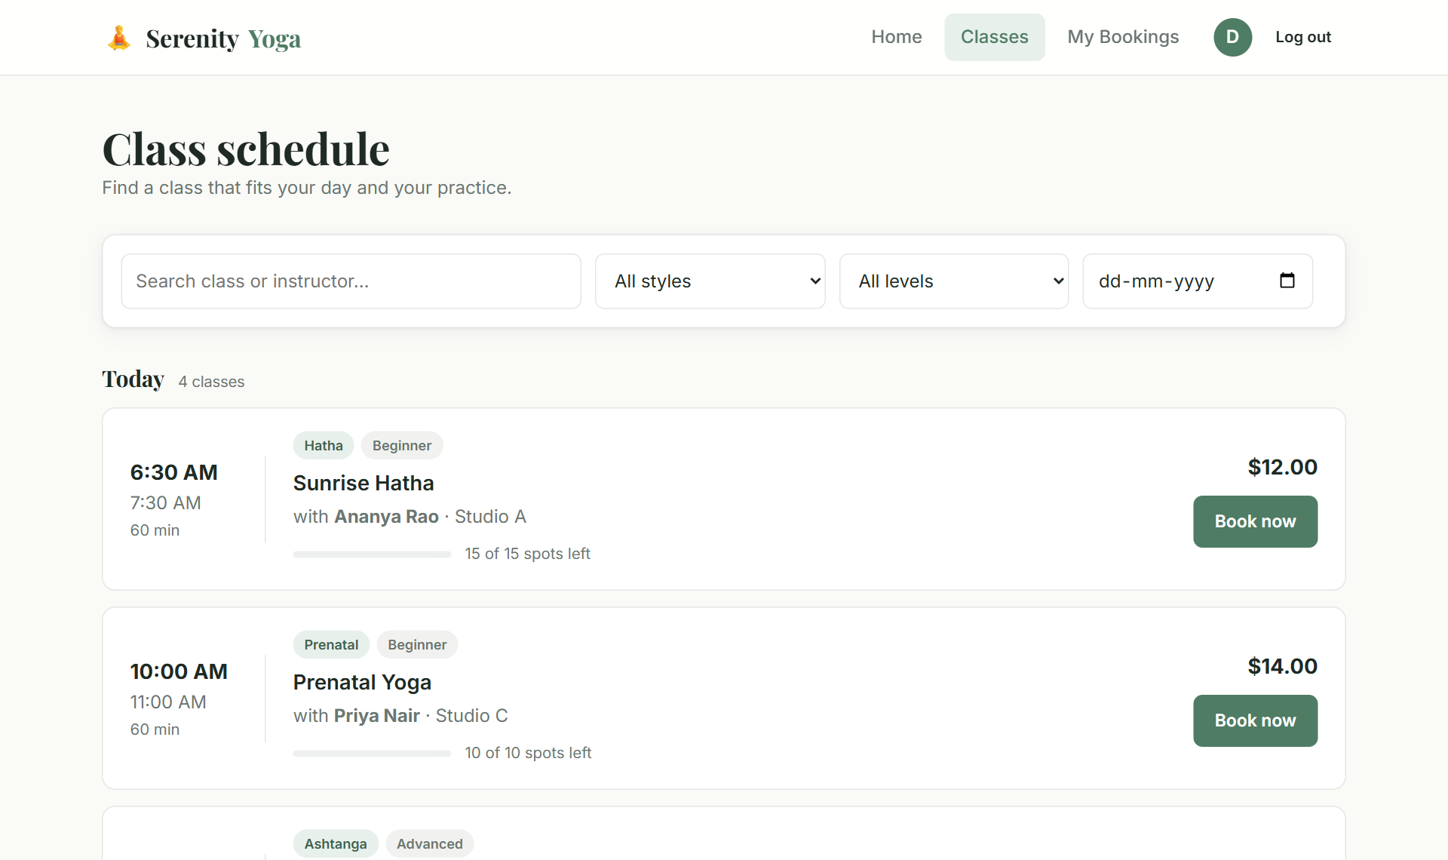
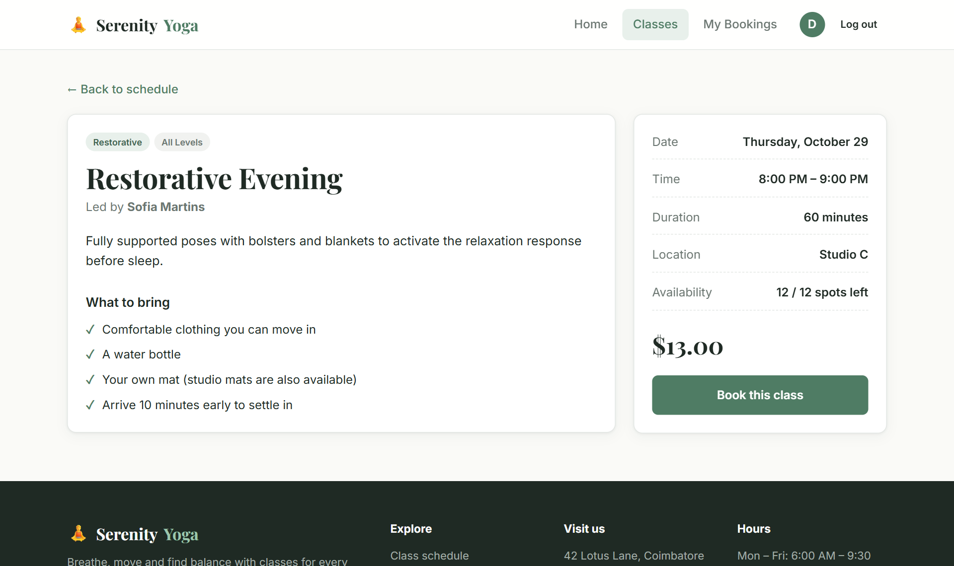
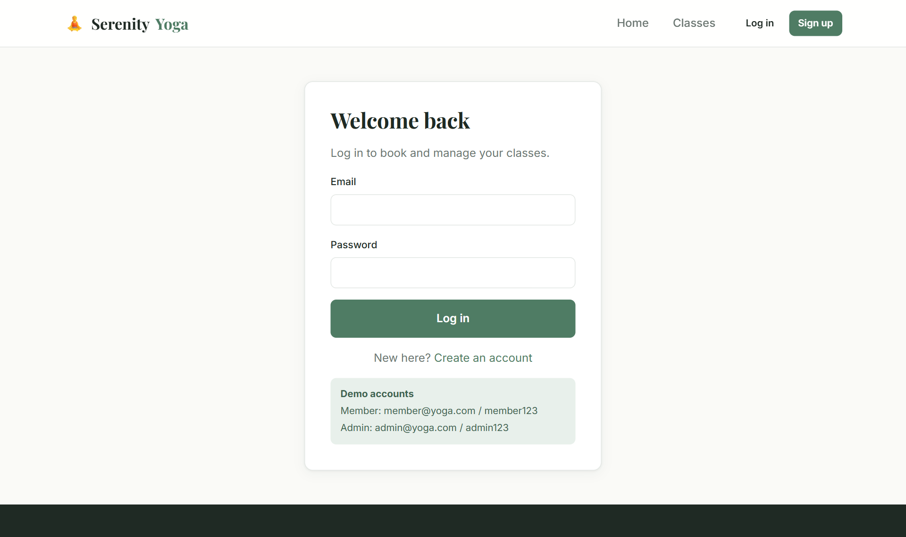
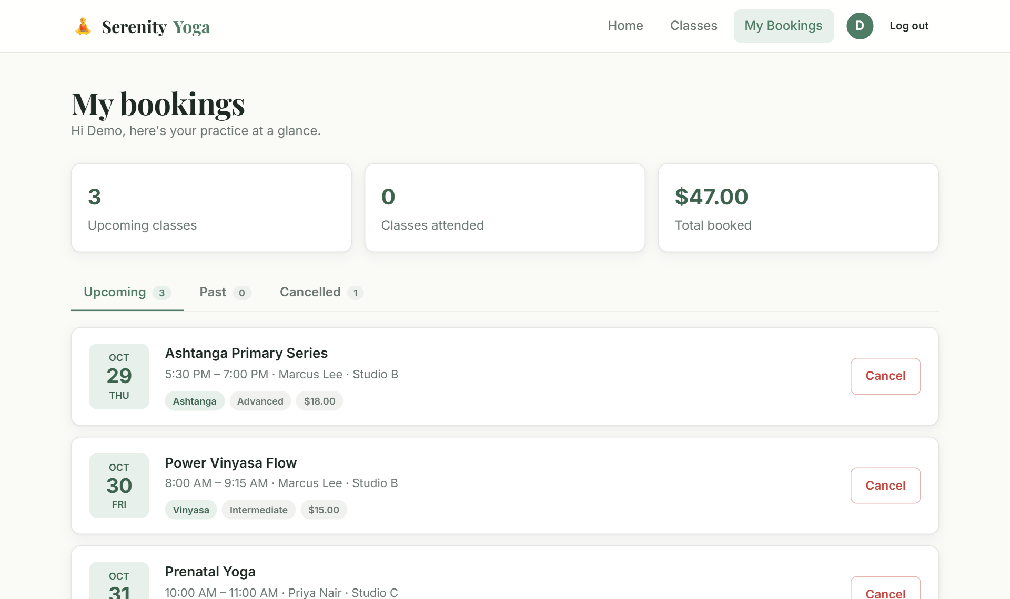
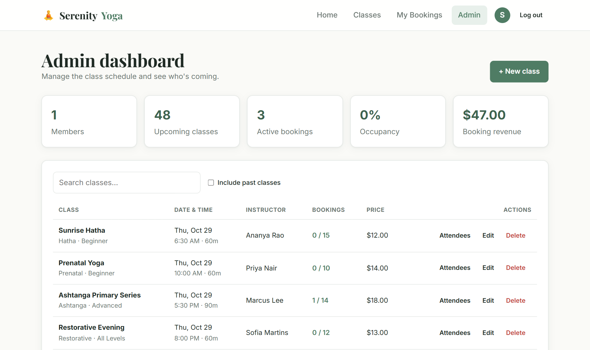
The interface: schedule, booking and administration
Home
Class schedule with filters
Class details and booking
Login with demo accounts
My bookings (member)
Admin dashboard
Notes:
Show the main screens. If possible, give a live demo here: browse, filter, book a class, check My Bookings, then log in as admin.

Slide 11
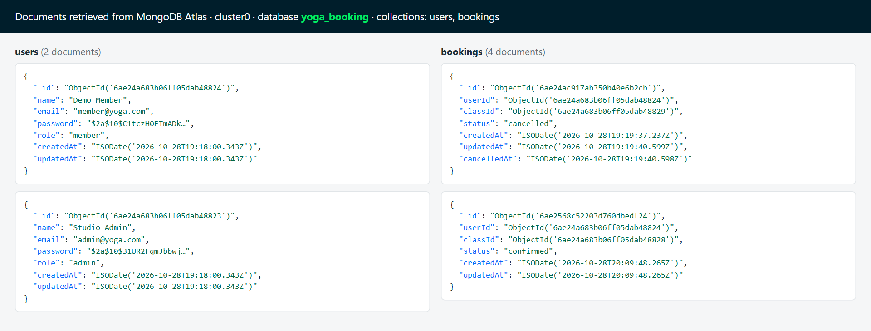
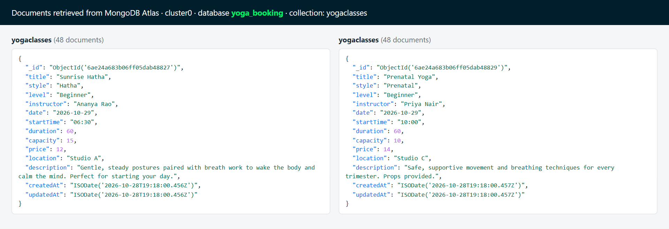
Data is stored in MongoDB Atlas
48
class documents
3
collections
1
cloud database
Documents retrieved from the yoga_booking database
Notes:
These are the real documents stored in the Atlas cluster. Note the ObjectId references in bookings, the bcrypt hash instead of a plain password, and the cancelled booking kept for history.

Slide 12

All end-to-end tests passed against MongoDB Atlas
Scenario | Result
Member login | JWT issued, password hidden | Pass
Book a class | Spots left 10 → 9 | Pass
Book the same class again | 409 “already booked” | Pass
List my bookings | Booking shown with class | Pass
Cancel, then re-book | Status cancelled → confirmed | Pass
Register a new user | Account created (201) | Pass
Admin stats and attendees | Counts and member listed | Pass
Admin create / edit / delete class | All succeeded | Pass
Malformed class id | 404 Not found | Pass
Member opens admin stats | 403 Admin access required | Pass
10 / 10
API scenarios passed
Notes:
These scenarios were run through the website address, so they also test the Vite proxy between frontend and backend. Each one checks a business rule or a security rule.

Slide 13

Conclusion
Future scope
A complete, working booking system: React UI, Express REST API and MongoDB Atlas
Live seat availability and strict server rules prevent overbooking
Secure accounts with bcrypt and JWT, and an admin role
Clean, responsive design that works on desktop and mobile
Online payments for class packs
Email / SMS reminders before class
Waiting list that fills cancelled spots
Instructor accounts and attendance marking
Recurring weekly class templates
Cloud deployment with CI from GitHub
Notes:
Summarise what was achieved, then the planned improvements.

Slide 14
Thank you
Questions?
STUDENT NAME (REG.NO) · Web Technology (23CS2048)
Demo logins – Admin: admin@yoga.com / admin123 · Member: member@yoga.com / member123
Notes:
Thank the panel and invite questions. Keep the demo logins on screen for a live demo.

